Slide 1
Statistical methods and Python basics for Machine Learning
Week 1

Slide 2
Introduction to Statistics
Statistics is a subfield of mathematics. It refers to a collection of methods for working with data and using data to answer questions.
Statistics is generally considered a prerequisite to the field of applied machine learning.
We will discuss the statistical tools commonly used for Data Science
Univariate analysis is the simplest form of data analysis where the data being analyzed contains only one variable. Since it's a single variable it doesn't deal with causes or relationships. The main purpose of univariate analysis is to describe the data and find patterns that exist within it.
Measures of Frequency: Count, Percent, Frequency,…
Measures of Central Tendency: Mean, Median, and Mode
Measures of Dispersion or Variation: Range, Variance, Standard deviation.
Measures of Position: Percentile Ranks, Quantile ranks

Slide 3
Statistics - Methods

Slide 4
Pattern Recognition

Slide 5
Association

Slide 6
Predictive Modeling

Slide 7
Types of Statistics
Types of Data

Slide 8
Some vital terms in Stats:
Population, Parameter, Sample, Statistic
A population is the universe of possible data for a specified object.
A parameter is a numerical value associated with a population.
A sample is a selection of observations from a population.
A Statistic is a numerical value associated with an observed sample.

Slide 9
Descriptive Statistics outline
Raw Data
Frequency Distribution – histograms
Cumulative Frequency Distribution
Measures of central tendency
Mean, Median, Mode
Measures of dispersion
Range, IQR, standard deviation, coefficient of variation
Normal distribution
Boxplots, QQ plots
Visualizations: scatter plot matrix
Correlation analysis
Five number summary

Slide 10
Sources and Types of data
Data Sources
Primary Data are collected by organization itself for a particular purpose. The benefits of primary data are that they fits the needs exactly and reliable.
Secondary Data are collected by other organizations or for other purposes. Any data, which are not collected by the organization for the specified purpose, are secondary data.
Types of datasets
Record
Graph and network
Ordered
Spatial, image and Multimedia

Slide 11
Data objects, attributes and its types
Data objects
Data sets are made up of data objects.
A data object represents an entity.
Data objects are described by attributes.
Examples:
sale database : customers, sales
medical database: patients, treatments

Slide 12
Attributes:
Attribute: a data field, representing a characteristic or feature of a data object. Example: customer_ID, name, address
Types:
Nominal
Binary
Ordinal
numeric
Attribute types
Nominal: categories, states or “names of things”
Hair_color = {black, brown, grey}
marital status, occupation, ID
Binary
Symmetric binary
Asymmetric binary
Ordinal

Slide 13
Mean/arithmetic mean/arithmetic average:
Is a central value of a finite set of numbers.
Specifically, the sum of the values divided by the number of values
Median
Median is the middle number in a sorted list of numbers
If odd number of values median = (n+1)/2
If even number of values median = [(n/2) + ((n/2)+1)]/2
Mode
Most frequent value in the dataset
Measure of dispersion
Measure of dispersion indicate how large the spread of
distribution in around the central tendency
Range: The difference between maximum and minimum value in dataset
Range = X_{maximum} – X_{minimum}

Slide 14
Inter Quartile Range (IQR): Q₃ – Q₁
There are several methods for determining outliers in a dataset:
Outliers are values below Q₁ - 1.5(Q₃ – Q₁) or Q₁ – 1.5*IQR
Outliers are values above Q₃ + 1.5(Q₃ – Q₁) or Q₃ + 1.5*IQR
Standard Deviation (SD):
measures the spread of the data about the mean
Variance: is the average squared
deviations from the mean.
(or)

Slide 15
Coefficient of variation (CV):
Coefficient variation is defined as ratio of standard deviation to mean
Standard error (SE): indicates how different the population mean is likely to be from a
sample mean. (or) SE is a mathematical tool used in statistics to measure variability.
It is also useful for the estimating the confidence interval for the dataset.
(or)
Covariance: is the measure of the directional relationship between two random variables
Correlation Coefficient (r): is used to describe the linear relationship between the two
Continuous variables. It ranges from -1.0 to 1.0
(or)

Slide 16
Mean Absolute Error (MAE): measure the average magnitude of the errors in a set of
Forecasts.
MAE is a model evaluation metric used with regression models.
Root Mean Square Error (RMSE) or Root Mean Square deviation (RMSD):
The RMSE is the square root of the variance of the residuals. RMSE is an absolute
fit of the model to the data-how close the observed data points are to the model’s
Predicted values.
y = Actual
y(cap) = predicted
Mean Squared Error (MSE) or mean squared deviation: the average squared
Differences between the estimated values and the actual value.

Slide 17
The Five Number Summary:
X_{smallest}
First Quartile (Q₁)
Median (Q₂)
Third Quartile (Q₃)
X_{largest}

Slide 18
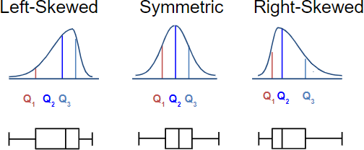
Distribution Shape and the Boxplot

Slide 19
Graphic Displays of Basic Statistical Descriptions
Boxplot: graphic display of five-number summary
Histogram: x-axis are values, y-axis repres. frequencies
Quantile plot: each value x_{i} is paired with f_{i} indicating that approximately 100 f_{i} % of data are ≤ x_{i}
Quantile-quantile (q-q) plot: graphs the quantiles of one univariant distribution against the corresponding quantiles of another
Scatter plot: each pair of values is a pair of coordinates and plotted as points in the plane

Slide 20
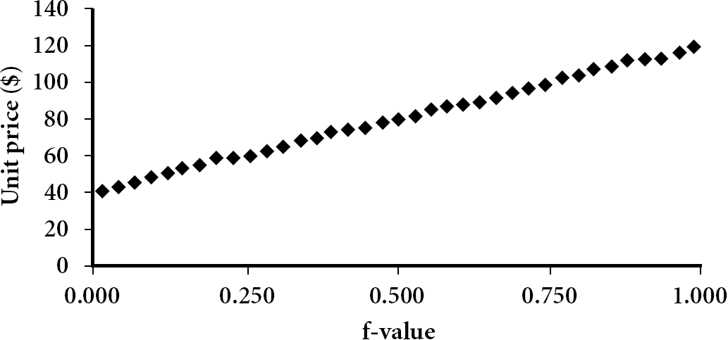
Quantile Plot
Displays all of the data (allowing the user to assess both the overall behavior and unusual occurrences)
Plots quantile information
For a data x_{i} data sorted in increasing order, f_{i} indicates that approximately 100 f_{i}% of the data are below or equal to the value x_{i}

Slide 21
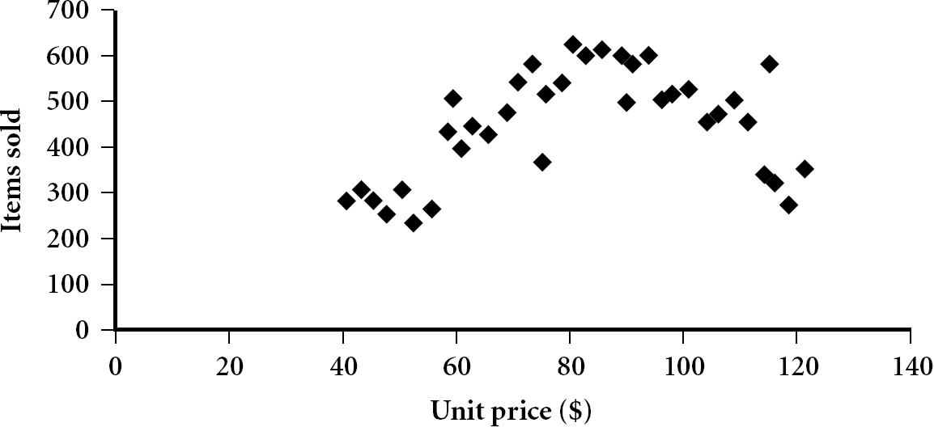
Scatter Plot
Provides a first look at bivariate data to see clusters of points, outliers, etc
Each pair of values is treated as a pair of coordinates and plotted as points in the plane

Slide 22
Data Visualization
Why data visualization?
Gain insight into an information space by mapping data onto graphical primitives Provide qualitative overview of large data sets
Search for patterns, trends, structure, irregularities, relationships among data Help find interesting regions and suitable parameters for further quantitative analysis
Provide a visual proof of computer representations derived
Categorization of visualization methods: Pixel-oriented visualization techniques
Geometric projection visualization techniques Icon-based visualization techniques Hierarchical visualization techniques Visualizing complex data and relations

Slide 23
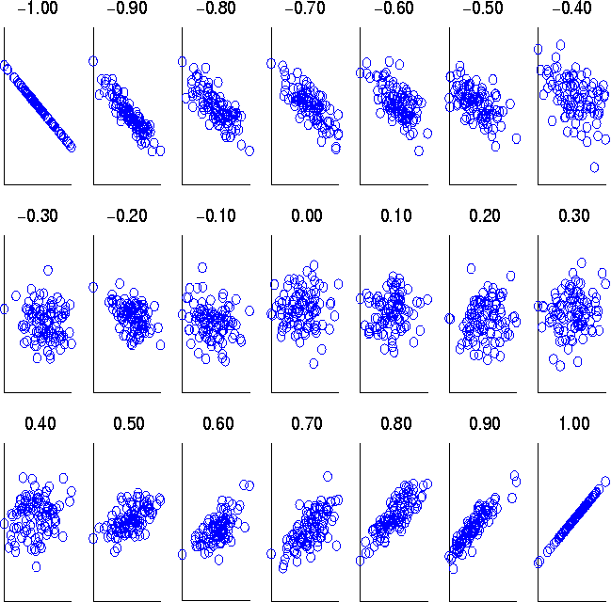
Visually Evaluating Correlation
Scatter plots showing the similarity from -1 to 1

Slide 24


